Slide 1
Facial Expression Classification using Deep Learning
Ahmad Karim
71403-0342655-7
DSAI - Gilgit - Section 4
meahmadkarim7@gmail.com
GitHub Profile Link:
https://github.com/meahmadkarim

Slide 2
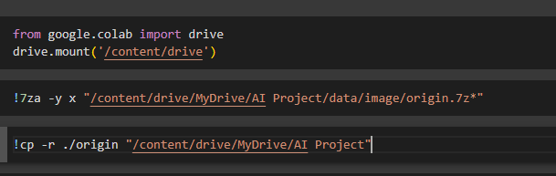
Mount Drive
Extract Files
Upload the data to your drive

Slide 3
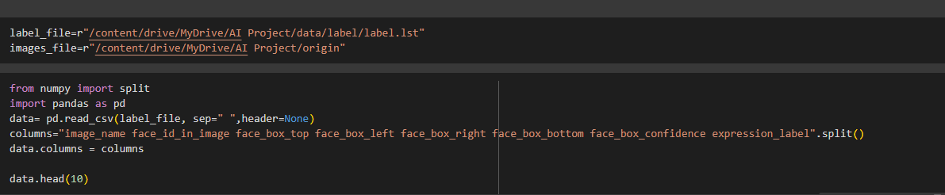
Read file from Drive
Change file to pandas data frame
Assign column names
Load 10 data from head

Slide 4
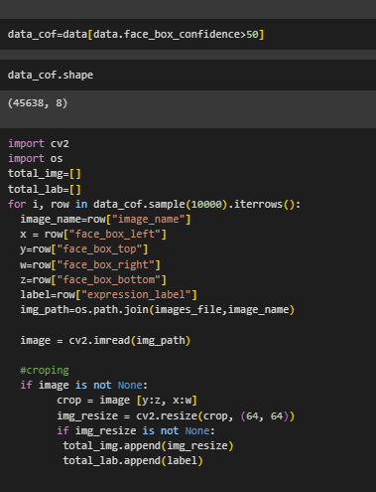
Set a threshold on the base of face confidence
Set to empty array:
tatal_img and tatal_lab
Iterate data with for loop
Select filename
Combine file name with path
Crop face from image
Resize image
Store image in tatal_img
Store label in tatal_lab

Slide 5
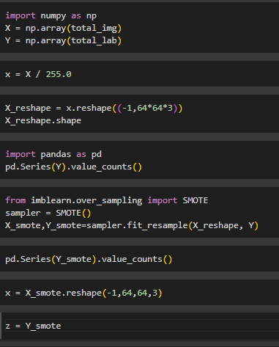
Change list to numpy array
Normalized x
Reshape x
SMOTE for Imbalanced Classification
Reshape X

Slide 6
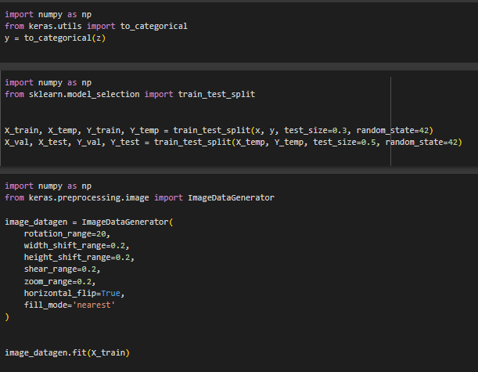
One hot encoding of Y
Split data into train, test and validation
Augmentation of data

Slide 7
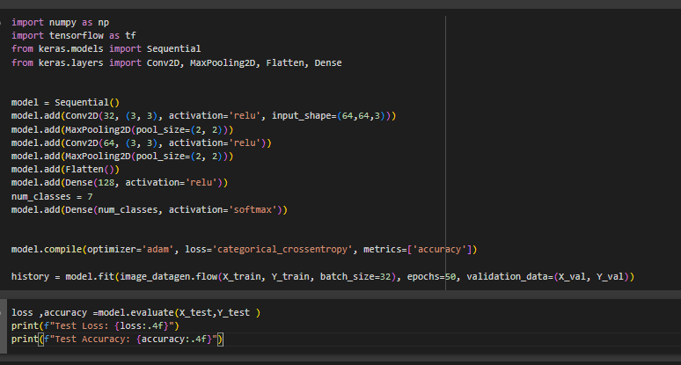
Creating a model
Training a moel
Evaluating model

